Slide 1

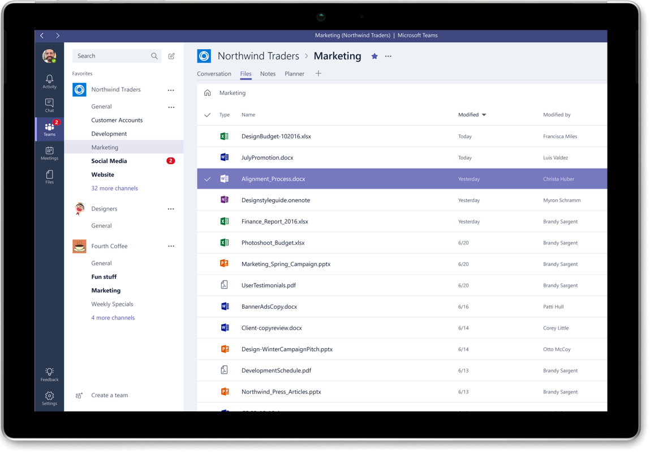

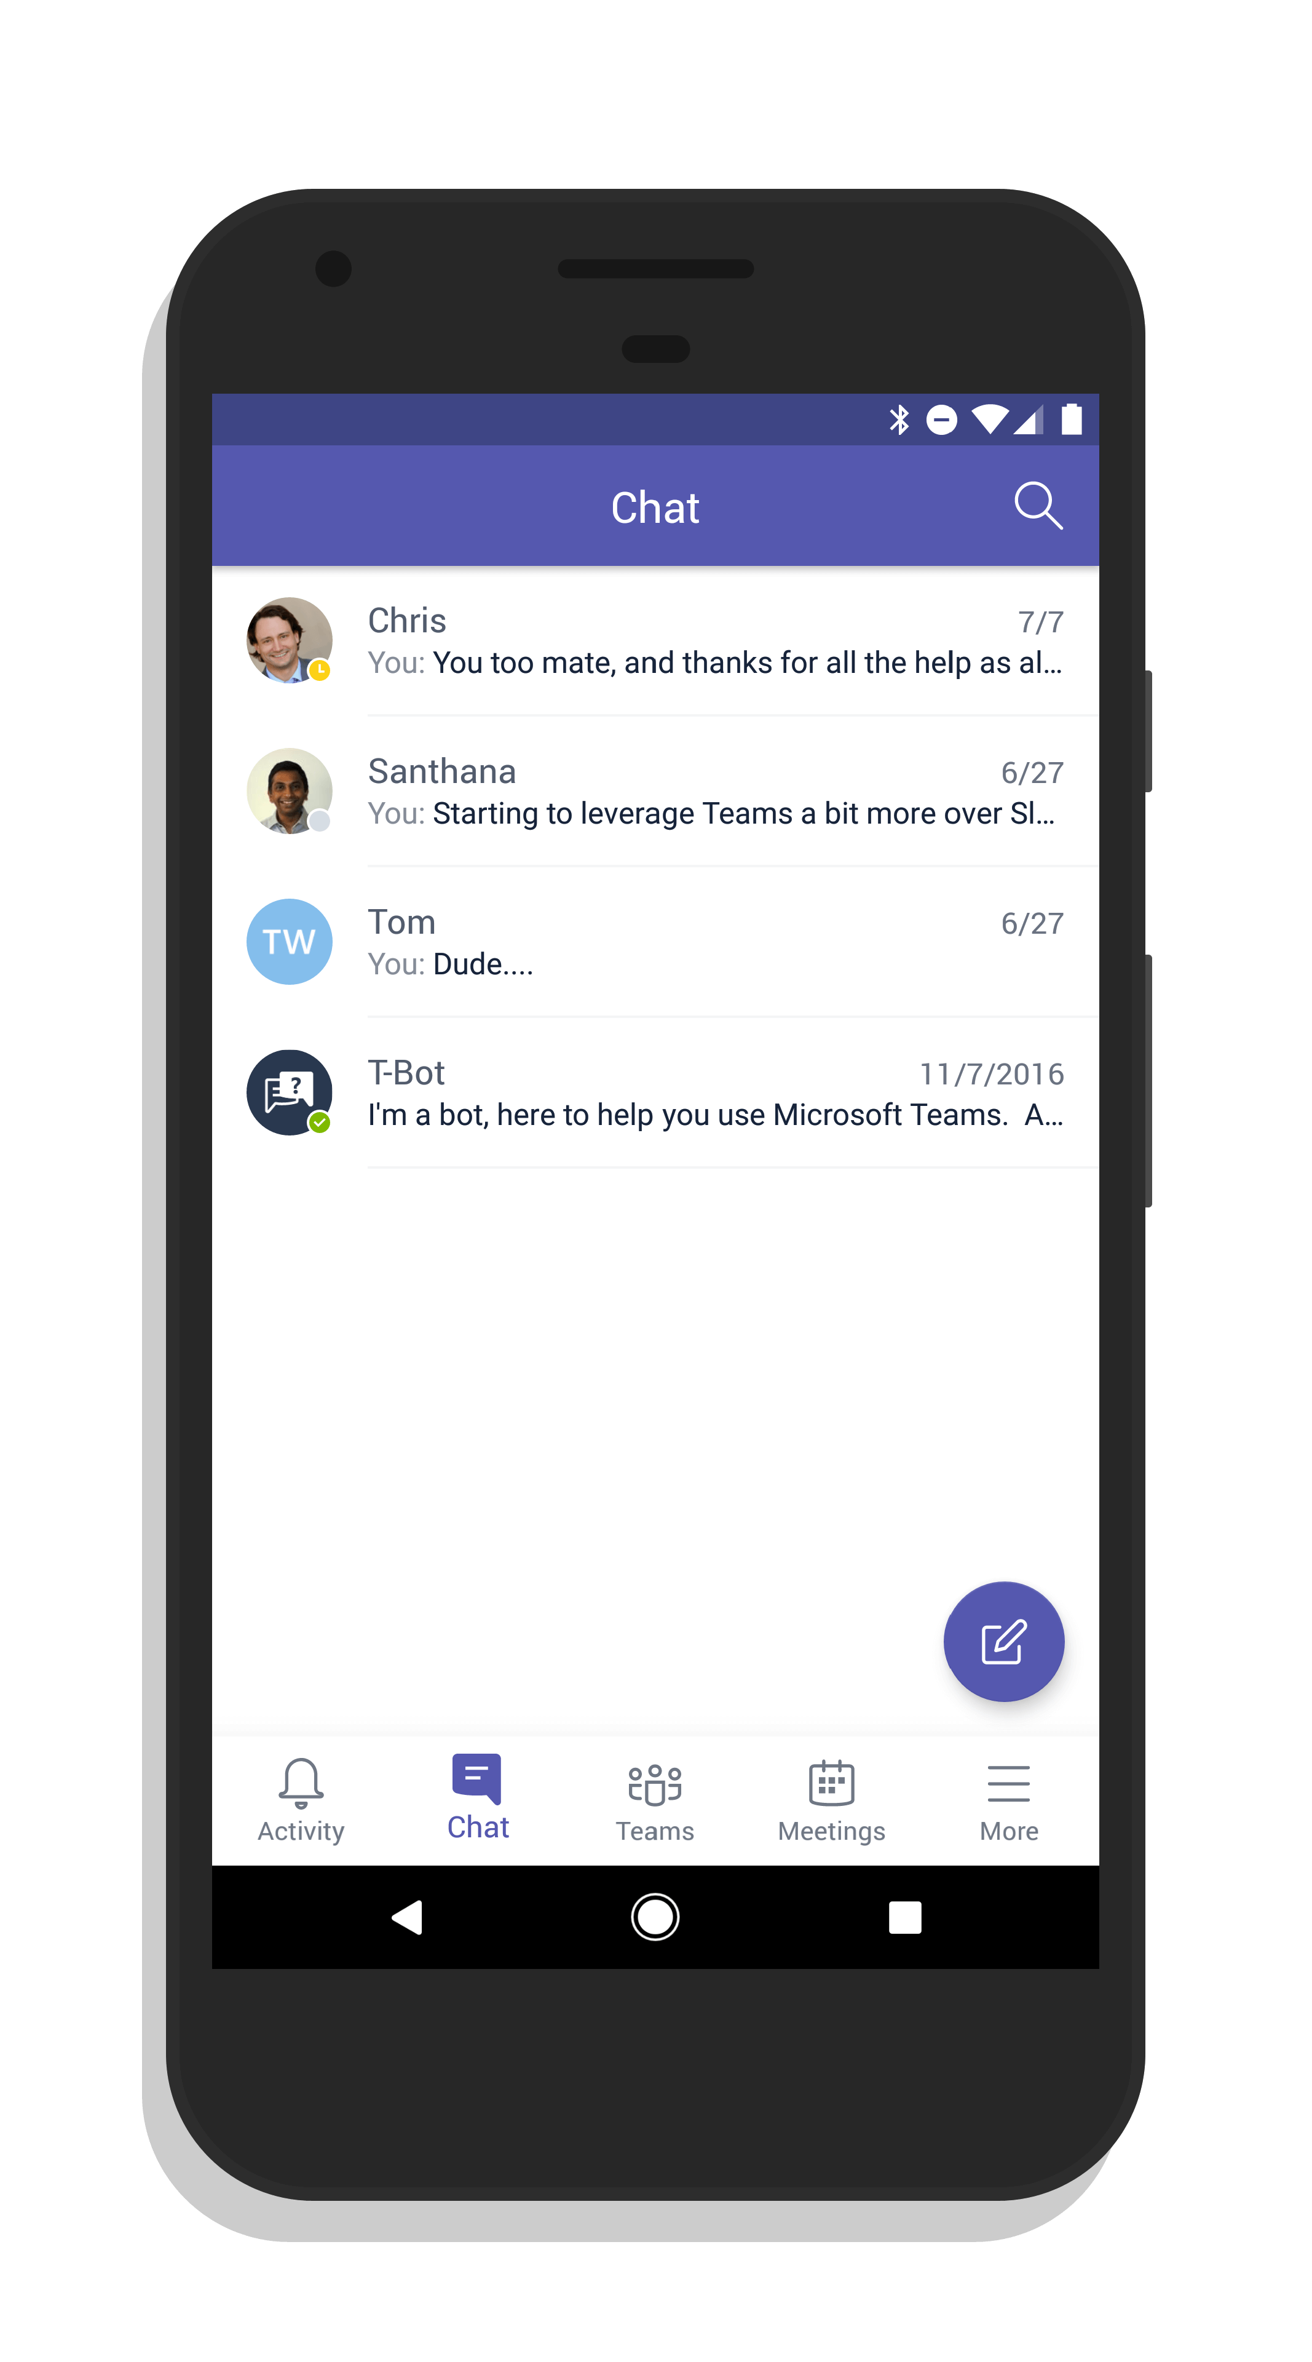

Talking Rain – Microsoft Teams
What We Did
Affirma worked with Talking Rain to implement and deploy Microsoft Teams across their entire organization. The Talking Rain team leverages their SharePoint to automate internal processes, distribute recent news, announcements, content, and collaborate on projects.
Affirma went on-site to conduct MS Teams training workshops with their BTI Product Innovation group. In just a few sessions, the BTI team had a baseline architecture to start confidently using Teams which also serves as an example for other business units at Talking Rain.
Affirma created a request process leveraging PowerApps and PowerAutomate to give users the ability to request Teams through a flexible process, while also giving IT the piece of mind that they were leveraging their Governance policies behind the scenes to keep things within their defined policies.
By leveraging Microsoft Teams, Talking Rain will be able to collaborate cross-departmentally along the entire product lifecyle, from ideation through production and distribution.

